Slide 1
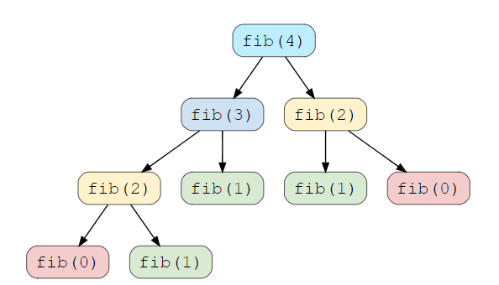
Dynamic Programming - Characteristics
In this category, I want to invest little more time because , in my complete coding interview experience, I feel that most of the time people are went blank, especially senior people who are not practicing code that often.
What is Dynamic Programming?
This is one of the favorite topic of coding interview.
Dynamic Programming (DP) is an algorithmic technique for solving an optimization problem by breaking it down into simpler subproblems and utilizing the fact that the optimal solution to the overall problem depends upon the optimal solution to its subproblems.
Let’s take the example of the Fibonacci numbers.
Fib(n) = Fib(n-1) + Fib(n-2), for n > 1
One important aspects of this set of problem that How to make sure or exact characteristics to define dynamic programing?
There are two characteristics of DP mainly
Overlapping sub problems
Optimal sub structure Property
“Any problem has optimal substructure property if its overall optimal solution can be constructed from the optimal solutions of its subproblems”

Slide 2
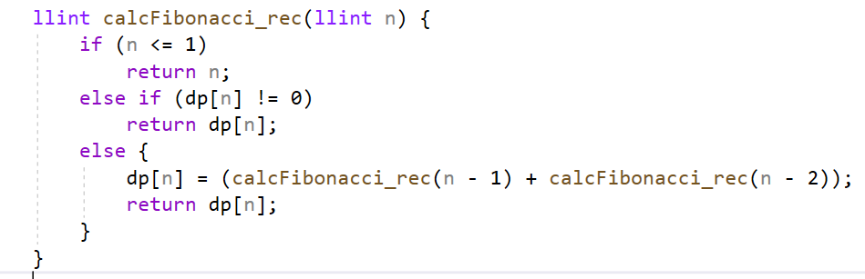
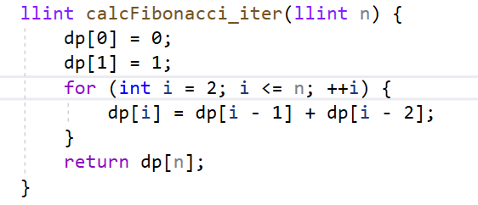
Dynamic Programming - Methods
DP offers two methods to solve a problem.
Top-down with Memorization – Approach 01
In this approach, we will try to solve the bigger problem by recursively finding the solution to smaller sub-problems. And by the way this is the most realistic and practical approach to solve any complex problem.
whenever we solve sub problems, we will cache them for future re-use. While reusing the cached solution, our benefit is in avoiding the re-solution to the problem which is already solved. This approach is called Memorization.
One Example of Fibonacci -
Compare the two Approach

Slide 3
Dynamic Programming - Methods
DP offers two methods to solve a problem.
Top-down with Memorization – Approach 01
In this approach, we will try to solve the bigger problem by recursively finding the solution to smaller sub-problems. And by the way this is the most realistic and practical approach to solve any complex problem.
whenever we solve sub problems, we will cache them for future re-use. While reusing the cached solution, our benefit is in avoiding the re-solution to the problem which is already solved. This approach is called Memorization.
One Example of Fibonacci -
Compare the two Approach

Slide 4
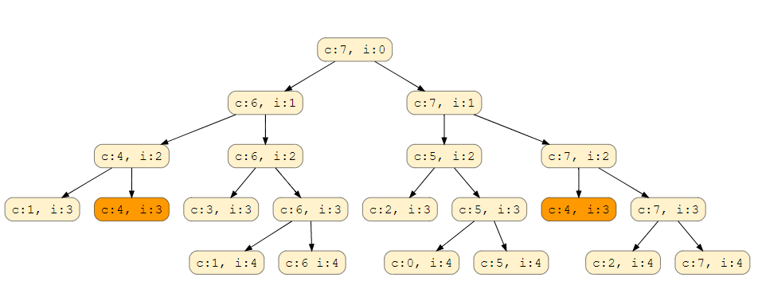
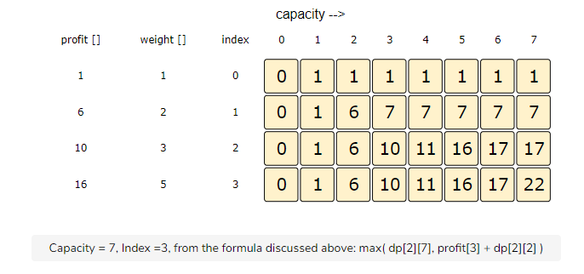
Dynamic Programming – 0/1 Knapsack
0/1 Knapsack Problem
Problem Statement
Given two integer arrays to represent weights and profits of ‘N’ items, we need to find a subset of these items which will give us maximum profit such that their cumulative weight is not more than a given number ‘C’.
Write a function that returns the maximum profit.
Each item can only be selected once, which means either we put an item in the knapsack or skip it.
Approach 01 : Memorization
Approach 02 : Tabulation

Slide 5
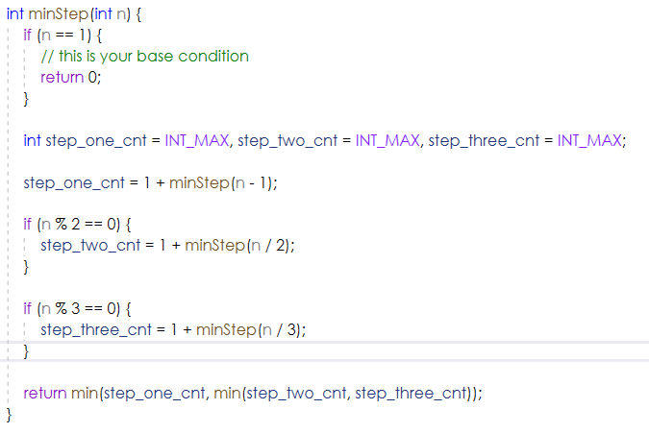
Dynamic Programming – Min Step Count
Problem Heading : Minimum Steps to One Problem
Problem statement
On a positive integer, you can perform any one of the following 3 steps:
1. Subtract 1 from it.
2. If it is divisible by 2, divide by 2.
3. If it is divisible by 3, divide by 3.
Given a positive integer n, find the minimum number of steps that takes n to 1.
Approach 01:
Brute Force, and the approach is like explore the all-possible paths and calculate the step required in path, out of all step count value , find the minimum number of count and return this minimum value as an output of this problem.
Time Complexity : O(3^m)
Space Complexity : Recursion stack required addition due to recursion

Slide 6
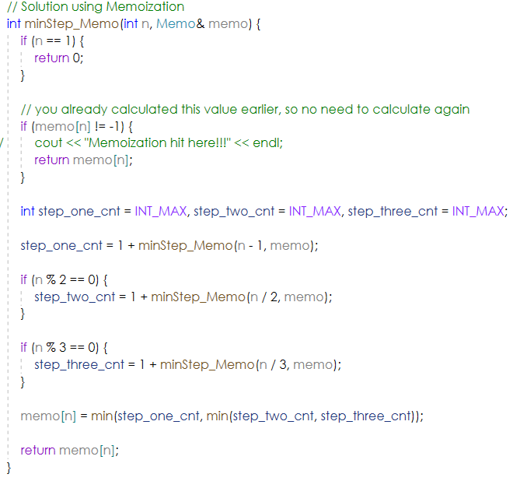
Dynamic Programming – Min Step Count
Problem Heading : Minimum Steps to One Problem
Problem statement
On a positive integer, you can perform any one of the following 3 steps:
1. Subtract 1 from it.
2. If it is divisible by 2, divide by 2.
3. If it is divisible by 3, divide by 3.
Given a positive integer n, find the minimum number of steps that takes n to 1.
Approach 02:
Top-down Memorization, what we observe here that
Time Complexity : 0(n)
Space Complexity : O(n)

Slide 7
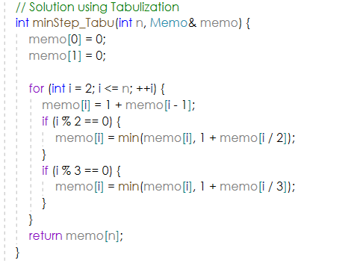
Dynamic Programming – Min Step Count
Problem Heading : Minimum Steps to One Problem
Problem statement
On a positive integer, you can perform any one of the following 3 steps:
1. Subtract 1 from it.
2. If it is divisible by 2, divide by 2.
3. If it is divisible by 3, divide by 3.
Given a positive integer n, find the minimum number of steps that takes n to 1.
Approach 03:
Bottom-up Tabulation,
Time Complexity : 0(n)
Space Complexity : O(n)

Slide 8
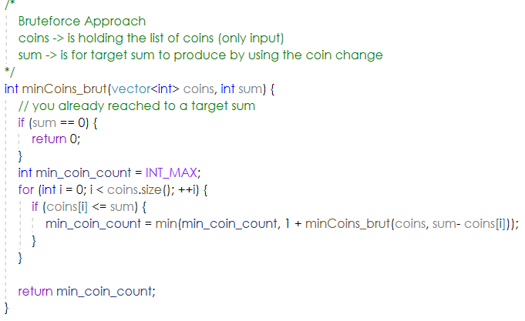
Dynamic Programming – Minimum coin change problem
Problem statement
If we have an infinite supply of each of C = { C_{1}C​1​​, C_{2}C​2​​, … , C_{M}C​M​​} valued coins and we want to make a change for a given value (N) of cents, what is the minimum number of coins required to make the change?
Approach 01:
Brute Force, and the approach is like try to produce all different possible combination and than select the minimum number of coin required.
So, two point to be considered here
Coin list is given in problem
Infinite supply of coin is given
Time Complexity : (m )^p // here m is the type of coins in list and p is the depth of your recursion tree
Space Complexity : We haven’t used any additional memory so O(1) which is const time
Example -> Input:
coins[] = {25, 10, 5}, N = 30
Output: Minimum 2 coins required
We can use one coin of 25 cents and one of 5 cents.
Input: coins[] = {9, 6, 5, 1}, N = 13
Output: Minimum 3 coins required
We can use combination of coin of 6 + 6 + 1 cents coins.
Code link : https://github.com/abmishra1234/4AM_Club_Coding/tree/main/11-02-2022_Project

Slide 9
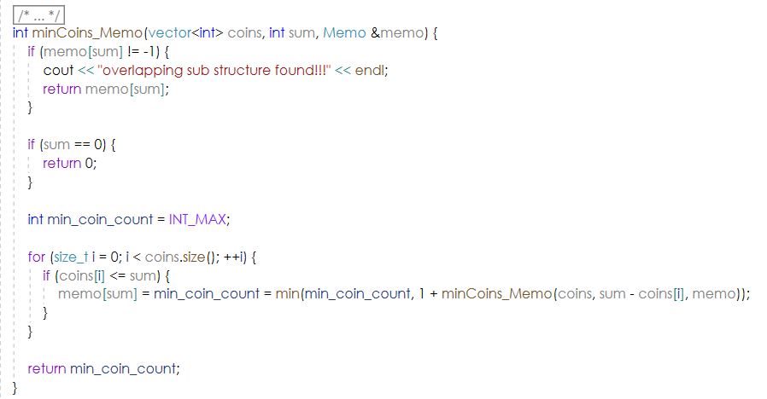
[Memoization] Minimum coin change problem
Problem statement
If we have an infinite supply of each of C = { C_{1}C​1​​, C_{2}C​2​​, … , C_{M}C​M​​} valued coins and we want to make a change for a given value (N) of cents, what is the minimum number of coins required to make the change?
Approach 02:
Top-down Approach(memorization),
So, here our approach will be to improve the problem we observed in brute-force approach
Yes, so let’s put down your observation on the overlapping substructure or duplicate recursion calls.
Observation
Let’s understand the overlapping sub structure using example,
Input: coins[] = {9, 6, 5, 1}, N = 13
Fn(13) = several possibilities
Picked 9 + Fn(4)
Picked 6 , picked 1 thrice + Fn(4)
Picked 5, picked 1 , 4 times + Fn(4)
So, you will see that many times we end-up at Fn(4) and this is the same we are trying to observe that
does here overlapping sub structure exist or not? And Yes, it exist so it the candidate of memorization.
Example -> Input:
coins[] = {25, 10, 5}, N = 30
Output: Minimum 2 coins required
We can use one coin of 25 cents and one of 5 cents.
Input: coins[] = {9, 6, 5, 1}, N = 13
Output: Minimum 3 coins required
We can use combination of coin of 6 + 6 + 1 cents coins.
Code link : https://github.com/abmishra1234/4AM_Club_Coding/tree/main/11-02-2022_Project

Slide 10
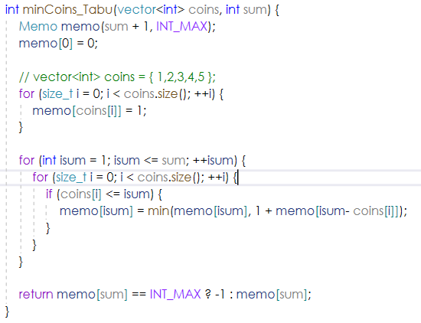
[Tabulation] Minimum coin change problem
Problem statement
If we have an infinite supply of each of C = { C_{1}C​1​​, C_{2}C​2​​, … , C_{M}C​M​​} valued coins and we want to make a change for a given value (N) of cents, what is the minimum number of coins required to make the change?
Approach 03:
Bottom-up Approach(Tabulation),
So, here our approach will be to improve the problem we observed in brute-force approach
Yes, so let’s put down your observation on the overlapping substructure or duplicate recursion calls.
Observation
Let’s understand the overlapping sub structure using example,
Input: coins[] = {9, 6, 5, 1}, N = 13
Fn(13) = several possibilities
Picked 9 + Fn(4)
Picked 6 , picked 1 thrice + Fn(4)
Picked 5, picked 1 , 4 times + Fn(4)
So, you will see that many times we end-up at Fn(4) and this is the same we are trying to observe that
does here overlapping sub structure exist or not? And Yes, it exist so it the candidate of memorization.
Example -> Input:
coins[] = {25, 10, 5}, N = 30
Output: Minimum 2 coins required
We can use one coin of 25 cents and one of 5 cents.
Input: coins[] = {9, 6, 5, 1}, N = 13
Output: Minimum 3 coins required
We can use combination of coin of 6 + 6 + 1 cents coins.
Code link : https://github.com/abmishra1234/4AM_Club_Coding/tree/main/11-02-2022_Project

Slide 11
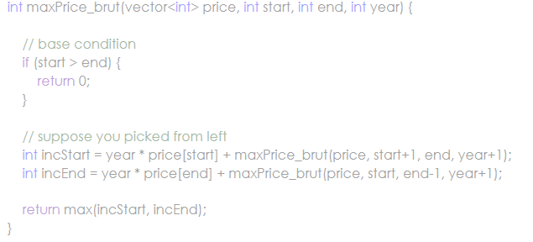
[Brute force] Wine and maximum price problem
Problem statement
If we have an infinite supply of each of C = { C_{1}C​1​​, C_{2}C​2​​, … , C_{M}C​M​​} valued coins and we want to make a change for a given value (N) of cents, what is the minimum number of coins required to make the change?
Approach 01:
Brute Force,
Example -> Input:
coins[] = {25, 10, 5}, N = 30
Output: Minimum 2 coins required
We can use one coin of 25 cents and one of 5 cents.
Input: coins[] = {9, 6, 5, 1}, N = 13
Output: Minimum 3 coins required
We can use combination of coin of 6 + 6 + 1 cents coins.
Code link : https://github.com/abmishra1234/4AM_Club_Coding/tree/main/11-02-2022_Project

Slide 12
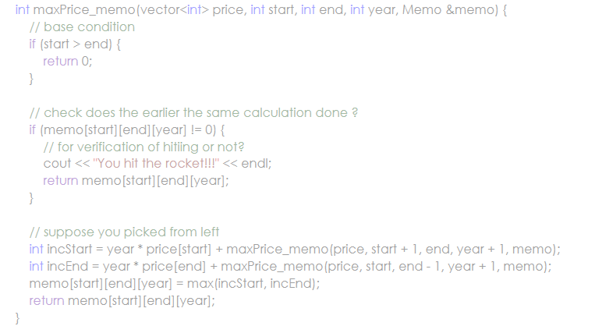
[Memorization] Wine and maximum price problem
Problem statement
If we have an infinite supply of each of C = { C_{1}C​1​​, C_{2}C​2​​, … , C_{M}C​M​​} valued coins and we want to make a change for a given value (N) of cents, what is the minimum number of coins required to make the change?
Approach 02:
Top-down Approach(memorization),
Example -> Input:
coins[] = {25, 10, 5}, N = 30
Output: Minimum 2 coins required
We can use one coin of 25 cents and one of 5 cents.
Input: coins[] = {9, 6, 5, 1}, N = 13
Output: Minimum 3 coins required
We can use combination of coin of 6 + 6 + 1 cents coins.
Code link : https://github.com/abmishra1234/4AM_Club_Coding/tree/main/11-02-2022_Project

Slide 13
[Tabulation] Wine and maximum price problem
Problem statement
If we have an infinite supply of each of C = { C_{1}C​1​​, C_{2}C​2​​, … , C_{M}C​M​​} valued coins and we want to make a change for a given value (N) of cents, what is the minimum number of coins required to make the change?
Approach 03:
Bottom-up Approach(Tabulation),
TBD.
Example -> Input:
coins[] = {25, 10, 5}, N = 30
Output: Minimum 2 coins required
We can use one coin of 25 cents and one of 5 cents.
Input: coins[] = {9, 6, 5, 1}, N = 13
Output: Minimum 3 coins required
We can use combination of coin of 6 + 6 + 1 cents coins.
Code link : https://github.com/abmishra1234/4AM_Club_Coding/tree/main/11-02-2022_Project

Slide 14
[Brute force] Longest common subsequence problem
Problem statement
Approach 01:
Brute Force,
Example -> Input:
coins[] = {25, 10, 5}, N = 30
Output: Minimum 2 coins required
We can use one coin of 25 cents and one of 5 cents.
Input: coins[] = {9, 6, 5, 1}, N = 13
Output: Minimum 3 coins required
We can use combination of coin of 6 + 6 + 1 cents coins.
Code link : https://github.com/abmishra1234/4AM_Club_Coding/tree/main/11-02-2022_Project

Slide 15
[Memorization] Wine and maximum price problem
Problem statement
If we have an infinite supply of each of C = { C_{1}C​1​​, C_{2}C​2​​, … , C_{M}C​M​​} valued coins and we want to make a change for a given value (N) of cents, what is the minimum number of coins required to make the change?
Approach 02:
Top-down Approach(memorization),
Example -> Input:
coins[] = {25, 10, 5}, N = 30
Output: Minimum 2 coins required
We can use one coin of 25 cents and one of 5 cents.
Input: coins[] = {9, 6, 5, 1}, N = 13
Output: Minimum 3 coins required
We can use combination of coin of 6 + 6 + 1 cents coins.
Code link : https://github.com/abmishra1234/4AM_Club_Coding/tree/main/11-02-2022_Project

Slide 16
[Tabulation] Wine and maximum price problem
Problem statement
If we have an infinite supply of each of C = { C_{1}C​1​​, C_{2}C​2​​, … , C_{M}C​M​​} valued coins and we want to make a change for a given value (N) of cents, what is the minimum number of coins required to make the change?
Approach 03:
Bottom-up Approach(Tabulation),
TBD.
Example -> Input:
coins[] = {25, 10, 5}, N = 30
Output: Minimum 2 coins required
We can use one coin of 25 cents and one of 5 cents.
Input: coins[] = {9, 6, 5, 1}, N = 13
Output: Minimum 3 coins required
We can use combination of coin of 6 + 6 + 1 cents coins.
Code link : https://github.com/abmishra1234/4AM_Club_Coding/tree/main/11-02-2022_Project

